Slide 1
A Non-Invasive Wireless Respiratory Monitoring System for Animals
K. Qiao, A. Nickerson, S. MacDonald, E. Ghafar-Zadeh
Dept. of EECS, Dept. of Psychology, York University, Toronto, Canada

Slide 2
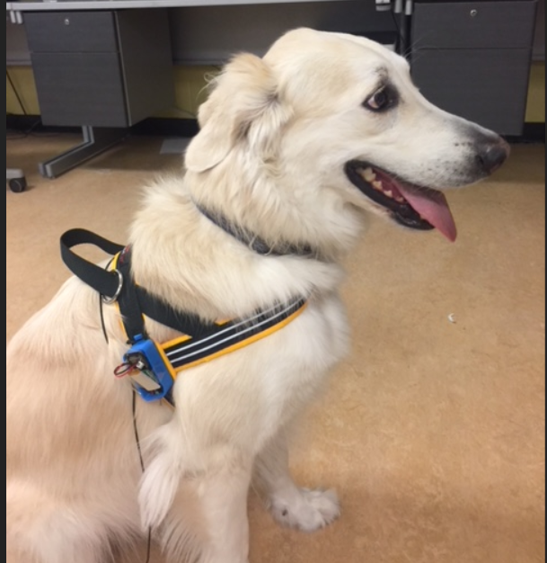
Abstract
The main objective of the project is to develop a biomedical device that can noninvasively monitor a dog’s breath rate using a conductive fabric.

Slide 3

List of features
Breath rate measurement
Temperature measurement
Wireless

Slide 4


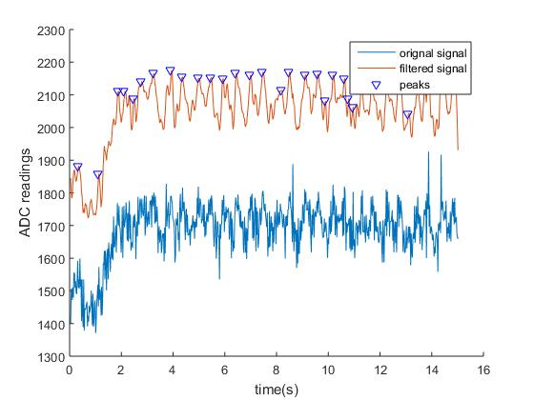
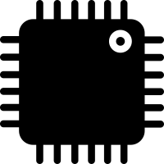



Hardware
Battery
Temperature sensor
Microcontroller
Wi-Fi
Personal computer
Results
Rubber cord stretch sensor

Slide 5

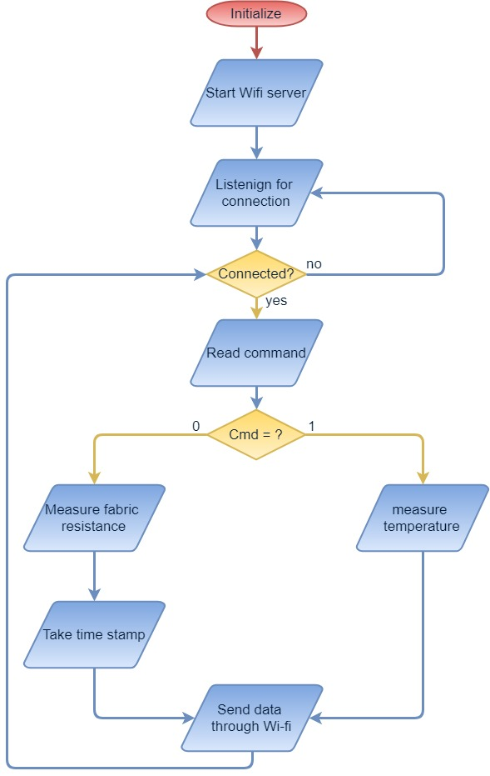


Software
Microcontroller program flow chart

Slide 6
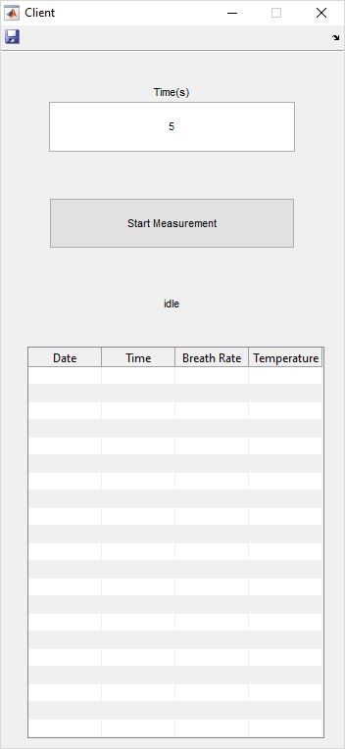

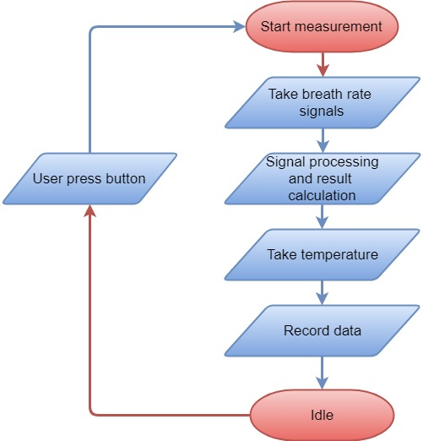
Software
MATLAB user interface and program flowchart

Slide 7

Demonstration

Slide 8
Thanks for watching

